Slide 1


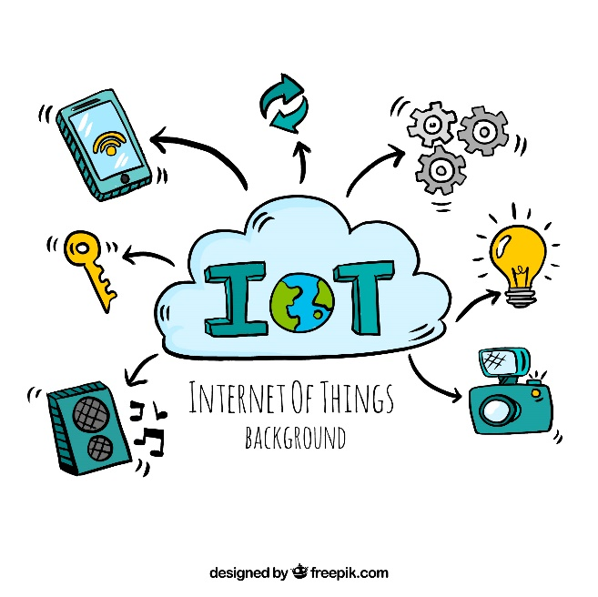


Possible Solution:
IoT Security
Date: 15.04.2018

Slide 2





Our Team
Hassan, Faria
ID: 16-31826-1
Alam, Rafayaat Rushafi
ID: 15-29837-2
Mehzabin, Raiya
ID: 15-29498-2
Rahman, Apshara
ID: 15-29495-1
Mahmud, MD.Tanzin
15-30433-3

Slide 3
What is IoT
Related to Computing Devices
Related to Mechanical and Digital machines
Provided with Unique Identifiers

Slide 4
IoT Security
Concerned with Safeguarding
Visibility and Monitoring connected Devices
Identity and Access Management

Slide 5

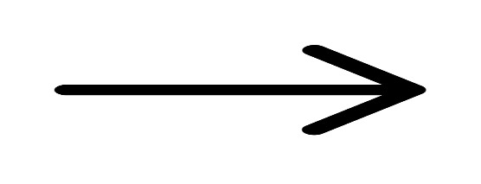


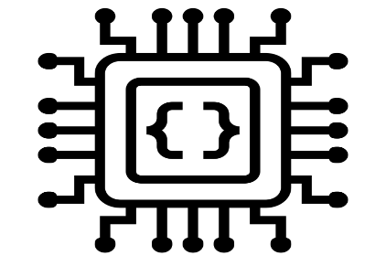


Security: Bridging The Gap Between Embedded and IT
HW world with HW Language
IT world with IT language
Embedded
Low Power
Low-Bitrate
Low-Cost
MCU
IPV6
TLS/SSL
VPN
Big data
Servers

Slide 6
What needs to be Solved
The cost of personalizing connected devices
Networking and security: the importance of “end-to-end”

Slide 7
Secure the IoT Devices and Products with SSL
Protect/Secure IoT Gateway
Data passed Web Server And Browser remain private
Securely and privately End-to-End
Use both symmetric and Asymmetric Cryptography

Slide 8

SSL involved to TLS
Elliptic Curve Cryptography(ECC) replaces RSA
Secure AES Session Key Derivation
Provides much shorter keys
Less Calculation with Higher level of Security
Very Simple and Automated of Sensor/Devices for Distant Application
Mutual Authentication
Yielding message integrity and Encryption

Slide 9
TLS Derivative May reduce the Problem
Genuine IP TLS is too Heavy with too much overhead for No IP Scenario
Should be the same functionalities as TLS
Smaller Certificates
Extended Session Key Validity
A Secure and Cheap Way to Personalize And Store Certificates Together

Slide 10


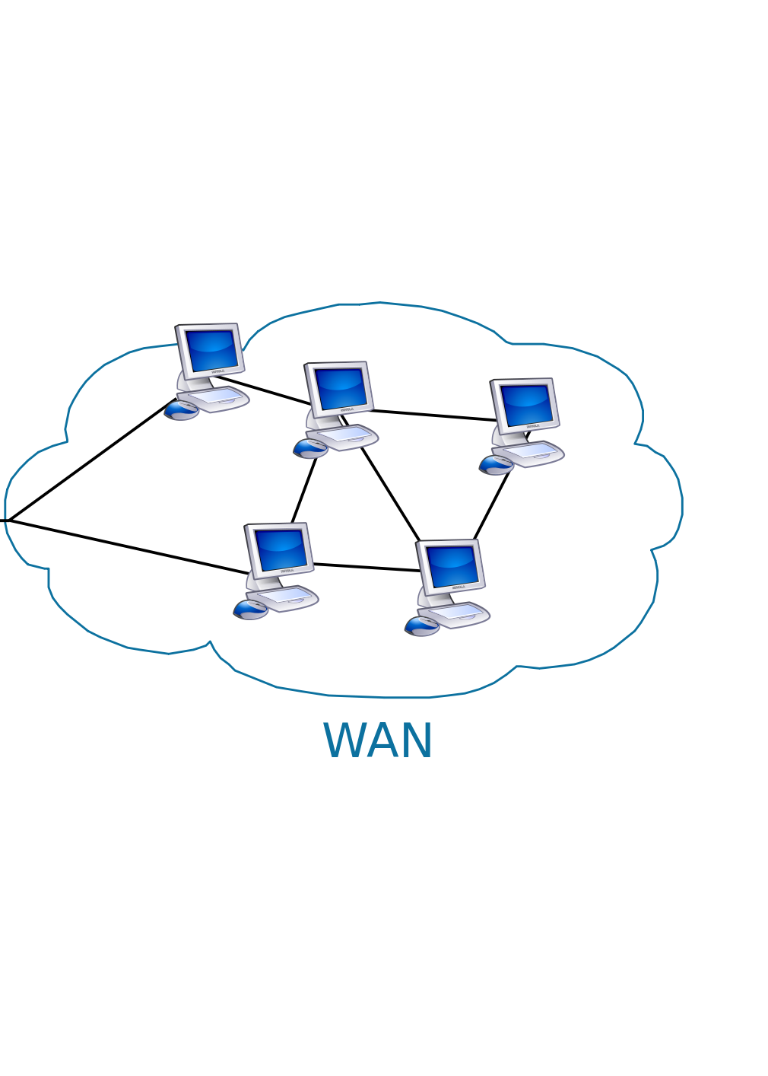
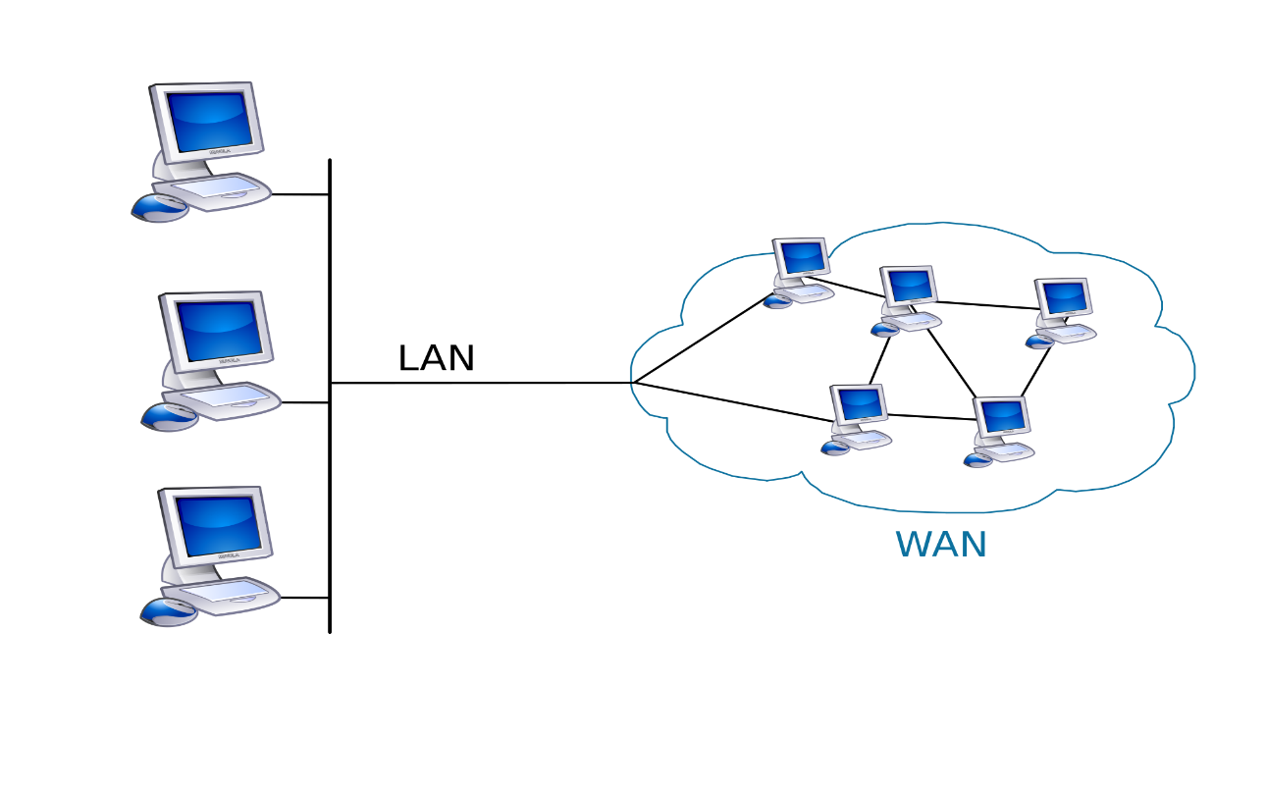


How about an extra layer of Device-to-Server Strong Security?
Not IP
Cellular Security
IPv6 Security
IPv6 Security

Slide 11
Ability of Secure Elements
Personalized Certificates
Secure Hosting of Secret Keys
Handling of Cryptography Primitives

Slide 12

Bottom Line: Personalizing a Connected Device
TLS or TLS like Stacks and APIs
Secure Elements able to host certificates
Trusted Certificate Authority Services

Slide 13


